Slide 1
HPV Vaccination Programme: Webinar for primary care
20th May 2025
NHS England Vaccination Team – East Midlands
East Midlands Cancer Alliance
Notes:
Standard title slide

Slide 3
HPV Vaccination programme and role of primary care
Dr Suzi McFall

Slide 4
This session will cover
Overview of the HPV vaccination programme.
NHS Cervical Cancer elimination plan.
HPV vaccination schedule – timing, eligibility and delivery.
HPV vaccination uptake in the Midlands.
National and regional actions.
How primary care can help.
Notes:
Plain slide with subhead and bullets

Slide 5
HPV and Cancer
HPV usually causes no symptoms and goes away by itself, but some types can cause genital warts or cancer.
Cervical cancer:
Cervical cancer is the most common cancer among women under the age of 35.
Most (99.8%) cases of cervical cancer are causes by persistent infection by high-risk HPV (of which HPV16 & 18 are the most common).
Cervical cancer leads to 285 deaths per year in England.
Cervical cancer incidence rates are 65% higher in the most deprived quintile compared with the least deprived.
Other cancers:
HPV is associated with numerous other cancers (anal, vaginal, vulvar, oropharyngeal, penile).
Notes:
Rephrase this in line with the cervical cancer elimination plan.
I think merge this slide with the cervical cancerl elimination plan slide.

Slide 6
Impact of HPV vaccination to date
Evidence from England:
A significant reduction in cervical cancer and incidence of Grade 3 Cervical Carcinoma In Situ (CIN3) in young women after the introduction of HPV vaccination programme.
Almost a 90% reduction in cervical cancer rates in women in their 20s who were offered the vaccine age 12 to 13.
By June 2019, there had been an estimated 448 fewer than expected cervical cancers and 17,235 fewer than expected cases of CIN3 in vaccinated cohorts.
Evidence from surveillance supports:
  very high vaccine effectiveness among those vaccinated
  a substantial herd protection effect with lower HPV16 and 18 prevalence over time in unvaccinated women
  No evidence of replacement by non-vaccine HPV types

Slide 7

NHS England cervical cancer elimination plan
In 2023, NHS England outlined the ambition to eliminate cervical cancer by 2040, aligning with the WHO global initiative.
Our ambition means reaching the following milestones:
By 2030, 90% of girls fully vaccinated with the HPV vaccine by age 15.
2023/24 uptake in East Midlands is 75%.
By 2040, cervical cancer incidence rate below 4 per 100,000 women.
Current incidence in England is 5 per 100,000 women.

Slide 8
HPV Vaccination programme in England over time
September 2008
National HPV Immunisation Programme began throughout the UK
3-dose programme (Cervarix® 16,18) delivered mainly in schools (with GP delivery in a small minority of areas)
school Year 8 females (aged 12 to 13 years)
catch up for all girls aged between 13 to 18 years
Gardasil® (6,11,16,18) 3-doses
move to a 2-dose programme min 6 months apart for girls starting before age 15 years
after a successful pilot the vaccine was extended to GBMSM up to 45 years of age attending local specialist Sexual Health Services and/or HIV clinics
the HPV adolescent programme was extended to boys as well as girls (universal offer)
move to a 2-dose schedule extended to all those eligible for the adolescent programme and GBMSM programme except for those who are immunosuppressed or living with HIV at the time of vaccination
move to Gardasil9® (6, 11, 16, 18, 31, 33, 45, 52, 58)
move to a 1-dose schedule for the routine adolescent programme and GBMSM programme for individuals less than 25 years of age.
September 2012
September 2014
April 2018
September 2019
April 2022
July 2022
September 2023
Notes:
Plain slide with subhead and bullets

Slide 9
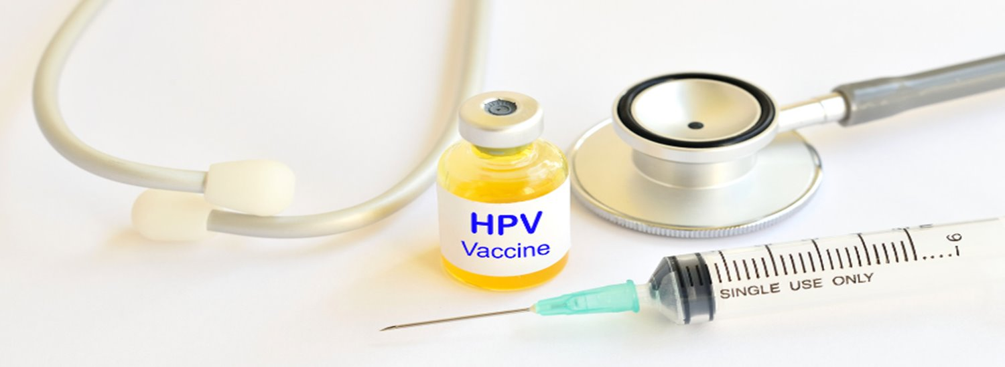
Current HPV Vaccination Schedule
​ | Eligible population​ | Where to get the vaccine​
Cohort 1​ | Children aged 12 to 13 (school year 8)​ | Secondary school (or community clinics for those not in school)​
Cohort 2​ | Girls aged 14 up to their 25th birthday and boys born after 1 September 2006 up to their 25th birthday who missed having the vaccine at school​ | Via the school nurse, school vaccination team (up to the age of 16 years) or GP surgery (post 16 years)
Cohort 3​ | Gay, bisexual and other men who have sex with men (GBMSM) and other at-risk individuals (up to 46th birthday) not previously vaccinated​ | Sexual health clinic or HIV clinic​
Notes:
GP practices will be aware that HPV programme reverts to GP delivery post 16yrs.
They will also be aware that HPV can be given to those who fall in the school age cohort should they prefer to attend GP and should not be turned away.

Slide 10
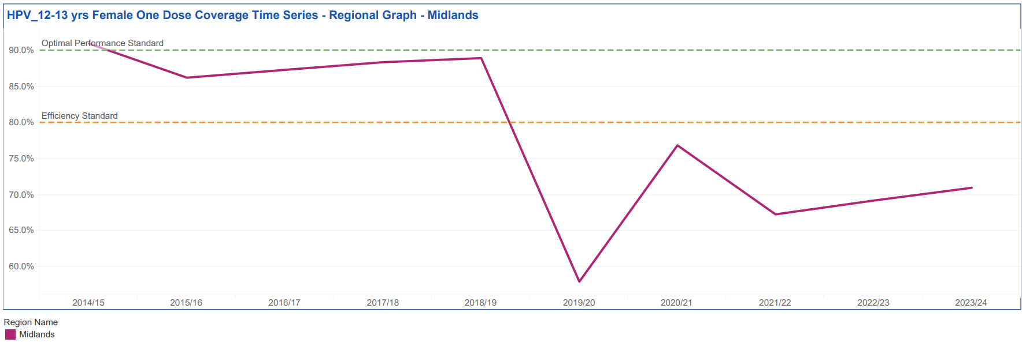
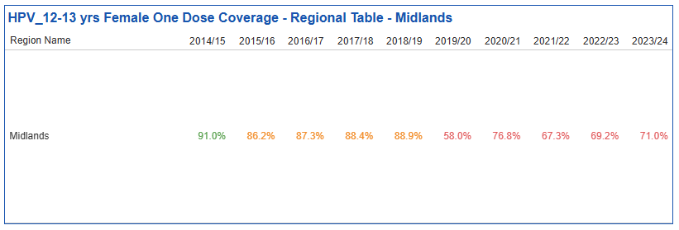
HPV Vaccine uptake in the Midlands - Girls
School uptake impacted by the pandemic and has not yet recovered.
90% target was met in 2014/15 but not since then.

Slide 11
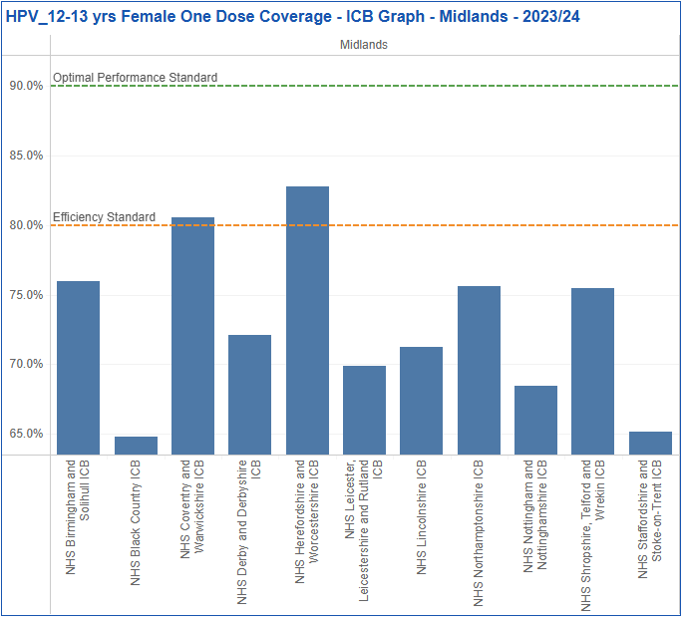
HPV Vaccine uptake by ICB - Girls
Inequalities in uptake apparent at ICB level.
No Midlands’ ICBs meeting the 90% target.
2023/24 HPV vaccination uptake by ICB​
ICB​ | Girls (dose 1 )​
Derby and Derbyshire​ | 72.1%​
Leicester, Leicestershire and Rutland​ | 69.9%​
Lincolnshire​ | 71.3%​
Northamptonshire​ | 75.6%​
Nottingham and Nottinghamshire​ | 68.4%​
England​ | 72.9%​

Slide 12
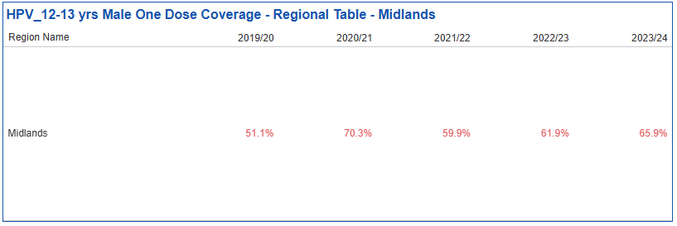
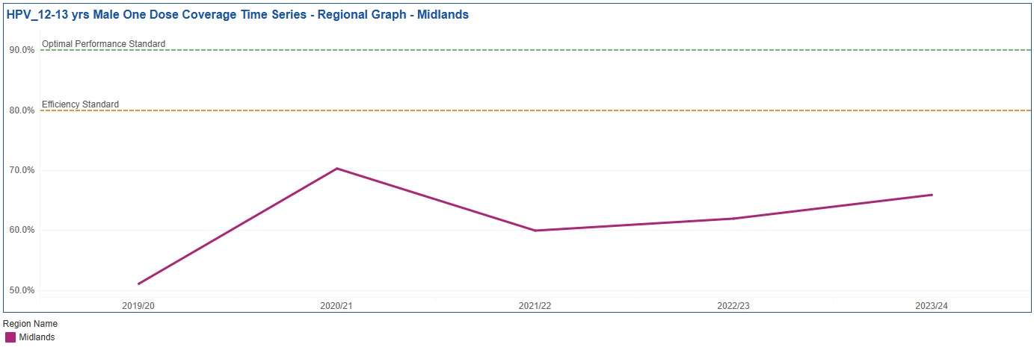
HPV uptake in the Midlands - Boys
Lower uptake in boys compared to girls (4% lower at Midlands level).
Aiming for 90% uptake in boys.
2023/24 HPV vaccination uptake by ICB​
ICB​ | Boys (dose 1)​
Derby and Derbyshire​ | 65.3%​
Leicester, Leicestershire and Rutland​ | 64.8%​
Lincolnshire​ | 65.1%​
Northamptonshire​ | 74.2%​
Nottingham and Nottinghamshire​ | 61.7%​
England​ | 67.7%​

Slide 13
National and regional level actions
Strengthening core offer through school-age immunisation services (SAIS):
Strengthening catch-up offers up to 16 years.
New digital product (MAVIS) to improve consent process, recording and sharing of vaccine events across SAIS and GPs.
Comms/engagement:
Building understanding of barriers and perceptions of HPV vaccination.
Coproduction of public facing materials and targeted messaging for underserved communities.
Expansion of delivery settings/locations for HPV catch-up:
Delivery of local models by ICBs tailored to their population.
Workforce:
Ensuring vaccinators have received sufficient training and feel confident in Gillick competence.

Slide 14
How can primary care help?
Offering opportunistic catch-up HPV vaccination to 16-24 year olds who have missed their school-age vaccine.
  Opportunistic vaccinations can be triggered by:
  Patient request
  MECC - Identification of gap in a patient’s vaccination record upon presentation with an unrelated issue or at other key points e.g. new patient registration.
Give the HPV vaccine to those aged 14-16yrs who fall in the school cohort should they prefer to attend their GP.
*Special request* Your practice will be sent a list of girls and boys age 16-18yrs unvaccinated for HPV (plus any other immunisations they are missing).
  Please contact these children by text and/or phone call and invite them to book an appointment to be vaccinated for HPV + any other missing immunisations.
  You can also contact any girls age 19-24yrs missing their HPV vaccination.
  For each vaccination dose delivered, a £10.06 item of service fee is payable under the General Medical Service Contract.

Slide 15
Thank you for listening

Slide 16


HPV and Cancer
Preventable cancers
Dr Pawan Randev
Primary Care Lead East Midlands Cancer Alliance
Notes:
Standard title slide

Slide 17

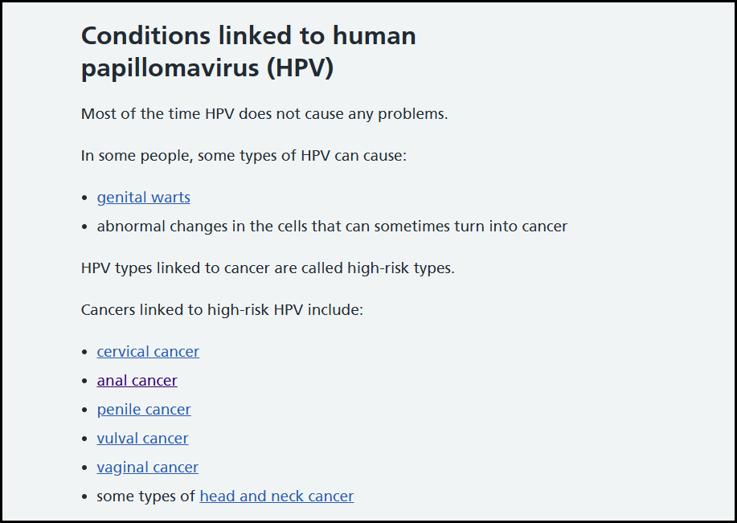
Which sites are implicated?
https://www.nhs.uk/conditions/human-papilloma-virus-hpv/
Notes:
Plain slide with subhead and bullets

Slide 18
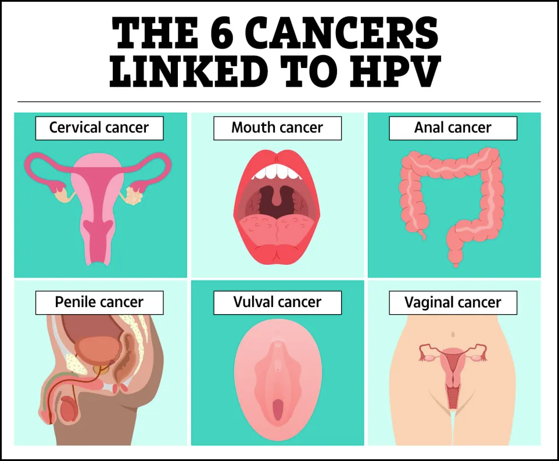
Which sites are implicated?
https://www.thesun.co.uk/health/33668010/children-missing-out-hpv-vaccine-protects-against-cancers/
Notes:
Plain slide with subhead and bullets

Slide 19
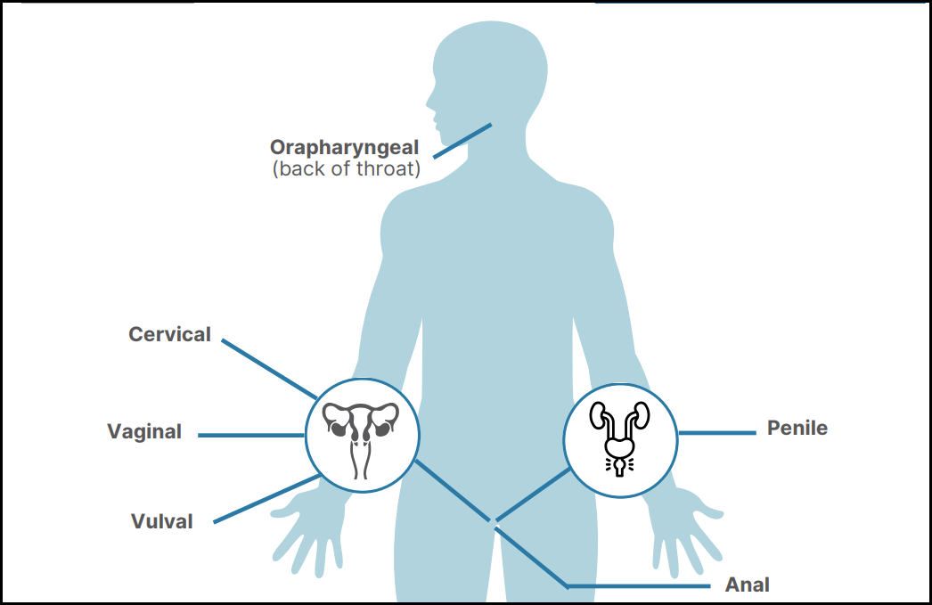
Main Sites of HPV Related Cancer
Notes:
Plain slide with subhead and bullets

Slide 20

Main Sites of HPV Related Cancer
Notes:
Plain slide with subhead and bullets

Slide 21
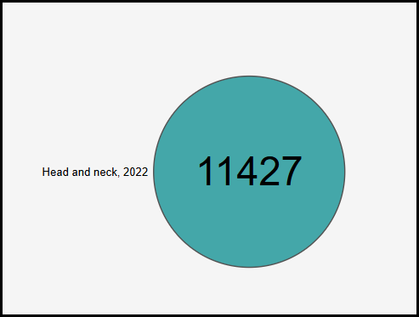
Main Sites of H and N Related Cancer 2022
https://nhsd-ndrs.shinyapps.io/get_data_out/
Notes:
Plain slide with subhead and bullets

Slide 22
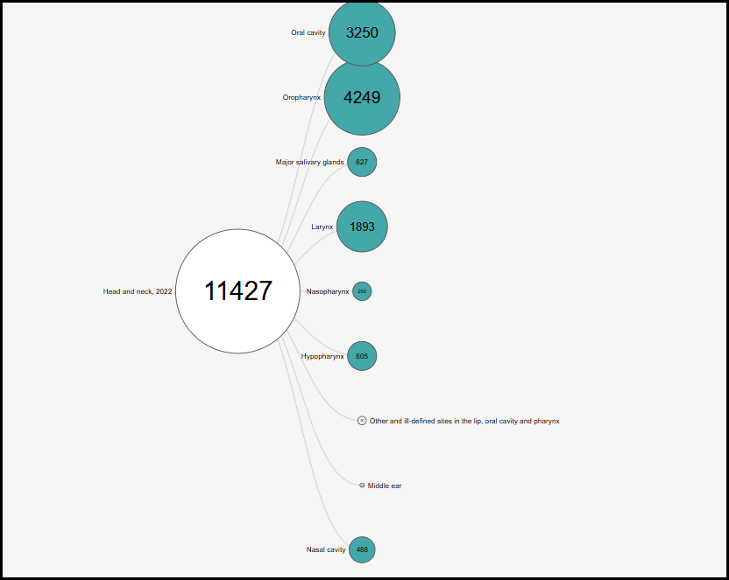
Main Sites of H and N Related Cancer 2022
Notes:
Plain slide with subhead and bullets

Slide 23
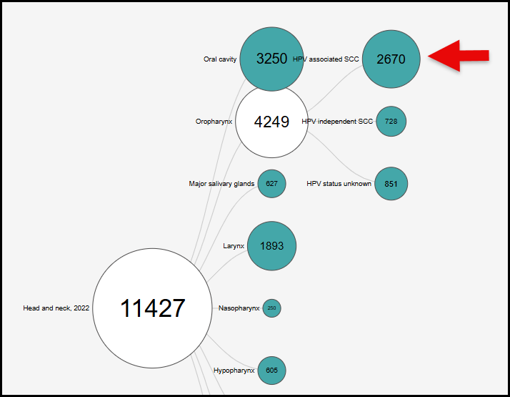
Main Sites of H and N Related Cancer 2022
Notes:
Plain slide with subhead and bullets

Slide 24
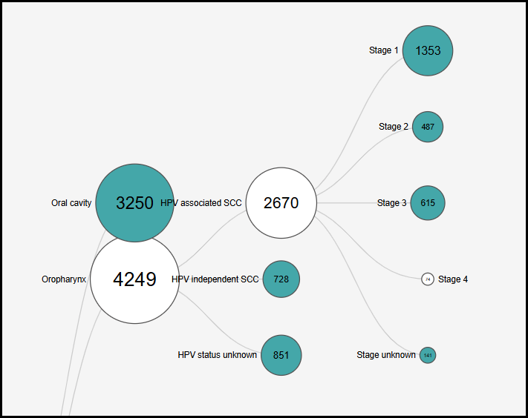
Main Sites of H and N Related Cancer 2022
Notes:
Plain slide with subhead and bullets

Slide 25
Main Sites of H and N Related Cancer 2022
Notes:
Plain slide with subhead and bullets

Slide 26
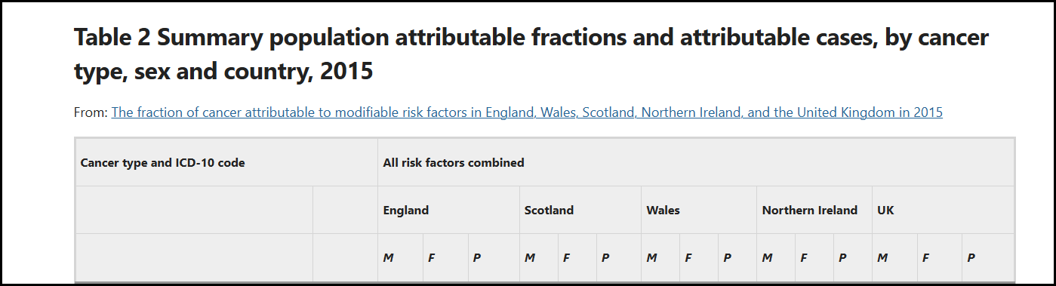
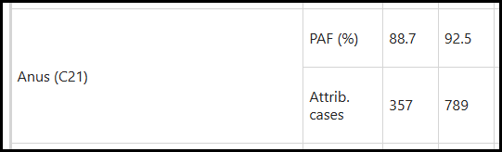
Anal Cancer – around 90% preventable
https://www.nature.com/articles/s41416-018-0029-6
Notes:
Plain slide with subhead and bullets

Slide 27
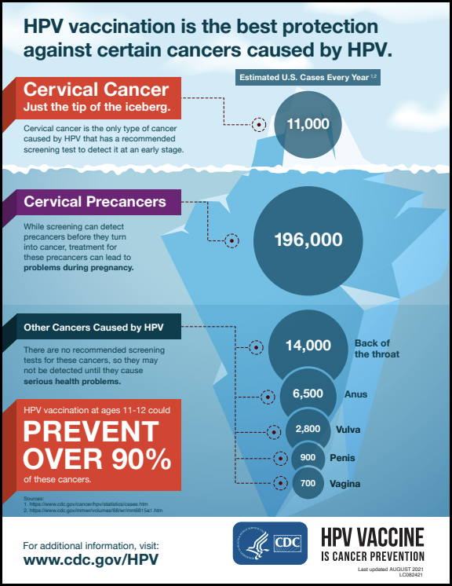
US Data 2021
https://www.maineaap.org/assets/resources/infographic-hpv-screening-508.pdf
Notes:
Plain slide with subhead and bullets

Slide 28
School Aged Immunisation Uptake - Lincolnshire
The graph below shows how vaccines in school age children has declined dramatically. Those eligible in 2021/22 will be the current school leavers which is why we need to act now.
PCN | Cohort | Vaccinated for HPV | HPV Uptake | HPV Unvaccinated
1 | 638 | 384 | 60% | 254
2 | 2012 | 1229 | 61% | 783
3 | 1022 | 689 | 67% | 333
4 | 864 | 668 | 77% | 196
5 | 1665 | 1303 | 78% | 362
6 | 1094 | 873 | 80% | 221
7 | 1353 | 1088 | 80% | 265
8 | 1515 | 1236 | 82% | 279
9 | 1189 | 984 | 83% | 205
10 | 839 | 696 | 83% | 143
11 | 1936 | 1615 | 83% | 321
12 | 1246 | 1051 | 84% | 195
13 | 1062 | 897 | 84% | 165
14 | 2139 | 1841 | 86% | 298
TOTAL | 18574 | 14554 | 78% | 4020
When reviewing the data at GP practice level, HPV coverage for 16-18 year olds ranges from 49% - 93%
Data Source: Data Source: Vaccine uptake guidance and the latest coverage data - GOV.UK and Child Health Information System (CHIS) February 2025

Slide 29

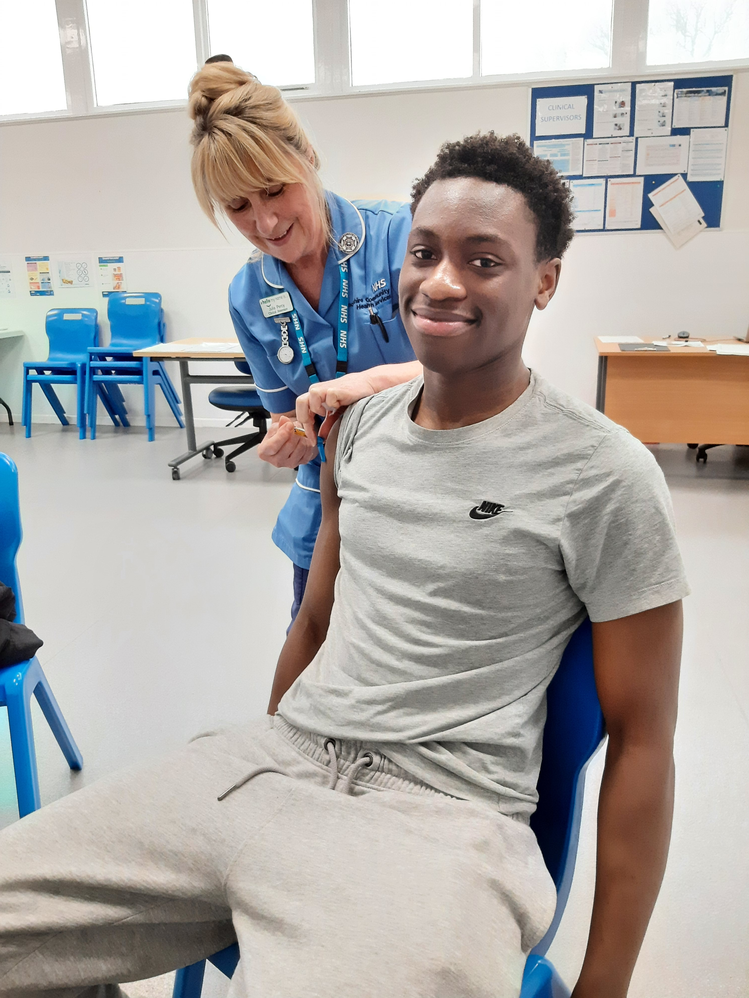
16-18 Year Olds Project Overview (Jan – March 2025)
Why?
5,500 young people aged between 16-18 years are missing at least one of either their Human Papillomavirus (HPV) or Meningococcal ACWY (MenACWY) vaccine.
This age group were directly impacted by the school closures during the COVID-19 pandemic, missing out on vaccinations that would have usually taken place in schools.
We have seen a decline in the return of consent forms over the past few years with more parental hesitancy to consent to childhood vaccinations than before.
At age 16, young people can consent to their own vaccinations more freely but may not be aware that they are missing their vaccinations.
Evidence already shows that delivering immunisations in schools reduces health disparities by making access to vaccines easier for all. Schools have a trusted relationship with pupils and can advocate for vaccinations.
Outcomes:
2799 views on the 16-18 Grab a Jab page.
662 enquiries received via email or phone (this was after missing imms letters).
36 engagement events have been held.
510 young people completed the survey.
79 vaccinations clinics have been held.
512 young people vaccinated (with 912 vaccines - HPV, MenACWY, Td/IPV and MMR).
158 young people completed patient feedback following vaccination.
Survey Summary:
90% of young people felt that getting vaccinated was important.
Most young people are aware there are vaccines for Flu and COVID-19, however 21% had not heard of HPV and 69% had not heard of MenACWY.
31% of young people are not aware that they are still entitled to vaccinations after missing them in school.
We are really pleased that this session was organised, it was especially good as we can now get our vaccinations during the school day without having to go out, and we don’t need consent from home to do it.
Staff was amazing, talked me through the vaccinations and helped me understand what I was putting into my body, thank you.

Slide 30
What could you do?
Display posters advertising SAIS and importance of HPV
Proactively invite young people for catch-up vaccinations after school leaver age (could include current Year 11’s as they have not left school to undertake exams).
An item of service fee will be paid as per other childhood vaccines of £10.06
National PGDs are available, and vaccine can be ordered free from ImmForm
Under Clinical Reporting on Ardens there is a suite of childhood folders where an eligible for HPV and MenACWY report can be found. Childhood Immunisations : Ardens
Enhanced Access hours can be used for vaccination catch up clinics as long as GP appointments are offered alongside. Saturdays and evenings may be particularly convenient for this cohort and so increase your utilisation of appointments.
It should be noted that most young people are not only missing their HPV vaccine, they are also missing their MenACWY and Td/IPV.
Resources are currently being developed but example text messages, letter templates and posters are embedded in this document:

Slide 31

Please complete the participation survey
https://forms.office.com/e/HwE0PvjQAT?origin=lprLink

