Slide 1

Faecal Immunochemical Testing
June 2026

Slide 2
When to do a FIT test
When to refer to a Lower GI suspected cancer pathway (and when not to)
Test Performance of FIT
Safety netting for FIT
FIT negative follow up

Slide 3
When to do a FIT test
1.3 Lower gastrointestinal tract cancers
Colorectal cancer
Recommendations 1.3.1 to 1.3.4 are adapted from NICE's diagnostics guidance on quantitative faecal immunochemical testing to guide colorectal cancer pathway referral in primary care.
1.3.1
Offer quantitative faecal immunochemical testing (FIT) using HM‑JACKarc or OC‑Sensor to guide referral for suspected colorectal cancer in adults:
with an abdominal mass or
with a change in bowel habit or
with iron-deficiency anaemia or
aged 40 and over with unexplained weight loss and abdominal pain or
aged under 50 with rectal bleeding and either of the following unexplained symptoms:
abdominal pain
weight loss or
aged 50 and over with any of the following unexplained symptoms:
rectal bleeding
abdominal pain
weight loss or
aged 60 and over with anaemia even in the absence of iron deficiency.
FIT should be offered even if the person has previously had a negative FIT result through the NHS bowel cancer screening programme. People with a rectal mass, an unexplained anal mass or unexplained anal ulceration do not need to be offered FIT before referral is considered. [2023]
1.3.2
Refer adults using a suspected cancer pathway referral for colorectal cancer if they have a FIT result of at least 10 micrograms of haemoglobin per gram of faeces. [2023]
1.3.3
For people who have not returned a faecal sample or who have a FIT result below 10 micrograms of haemoglobin per gram of faeces:
safety netting processes should be in place
referral to an appropriate secondary care pathway should not be delayed if there is strong clinical concern of cancer because of ongoing unexplained symptoms (for example, abdominal mass). [2023]
1.3.4
Clinicians should consider if people need additional help, information or support to return their sample. [2023]
1.3.5
Consider a suspected cancer pathway referral for colorectal cancer in adults with a rectal mass. [2015, amended 2023]
Anal cancer
1.3.6
Consider a suspected cancer pathway referral for anal cancer in people with an unexplained anal mass or unexplained anal ulceration. [2015]

Slide 4
When to do a FIT test
For people with suspected colorectal cancer
For people with low-risk-but-not-no-risk symptoms (For example, aged over 40 with isolated abdominal pain or weight loss but not both).
When you’re ordering a CA125 (and vice versa)

Slide 5
When not to do a FIT test
For people with anal mass or ulceration suggestive of anal cancer
For screening people without symptoms (unless screening fit….)
Repeatedly
For symptoms of short duration consistent with gastroenteritis

Slide 6
FIT thresholds for screening and symptomatic detection
What’s the difference and why does it matter?

Slide 7
The ideal test
We want a test that will distinguish these two populations
Diagnostic
Cut-off
Healthy
(total negatives)
Colorectal cancer
(total positives)
number of people
Faecal haemoglobin (f-Hb)
Notes:
We are using length as our diagnostic test. Ideally there would be no overlap between the length of raisins and peanuts. If this was the case, we would have a perfect test: anything< cut-off length is a raisin, anything > cut-off length is a peanut.
However…….

Slide 8
Real life is more complicated
Diagnostic
Cut-off
Healthy
(total negatives)
Colorectal cancer
(total positives)
number of people
10 ug/g
Faecal haemoglobin (f-Hb)
Notes:
We are using length as our diagnostic test. Ideally there would be no overlap between the length of raisins and peanuts. If this was the case, we would have a perfect test: anything< cut-off length is a raisin, anything > cut-off length is a peanut.
However…….

Slide 9
The 2x2 table: ‘low risk’ symptomatic population
 |  | True disease status
 |  | Colorectal cancer | No colorectal cancer
Faecal Hb level | >=10 (positive) | 43 | 575 | 618
 | < 10 (negative) | 8 | 3,264 | 3272
CRC incidence 1.3% |  | 51 | 3,839 | Total number of tested patients =3890
FIT threshold for symptomatic triage
PPV: 7%
NPV: 99%
FIT diagnostic performance:
Sensitivity 84%
Specificity 85%
Values from Bailey et al 2021 https://www.nature.com/articles/s41416-020-01221-9

Slide 10
The 2x2 table: symptomatic population
 |  | True disease status
 |  | Colorectal cancer | No colorectal cancer
Faecal Hb level | >=10 (positive) | 163 | 555 | 718
 | < 10 (negative) | 31 | 3,141 | 3272
CRC incidence 5% |  | 194 | 3,696 | Total number of tested patients =3890
FIT threshold for symptomatic triage
PPV: 22%
NPV: 96%
FIT diagnostic performance:
Sensitivity 84%
Specificity 85%
Values from Bailey et al 2021 https://www.nature.com/articles/s41416-020-01221-9

Slide 11
Symptomatic patients in primary care
Diagnostic
Cut-off
Colorectal cancer
(total positives)
Healthy
(total negatives)
number of people
10 ug/g
Faecal haemoglobin (f-Hb)
Notes:
We are using length as our diagnostic test. Ideally there would be no overlap between the length of raisins and peanuts. If this was the case, we would have a perfect test: anything< cut-off length is a raisin, anything > cut-off length is a peanut.
However…….

Slide 12
Asymptomatic patients invited to screening
Diagnostic
Cut-off
Colorectal cancer
(total positives)
Healthy
(total negatives)
number of people
10 ug/g
Faecal haemoglobin (f-Hb)
Notes:
We are using length as our diagnostic test. Ideally there would be no overlap between the length of raisins and peanuts. If this was the case, we would have a perfect test: anything< cut-off length is a raisin, anything > cut-off length is a peanut.
However…….

Slide 13
Asymptomatic patients invited to screening
Diagnostic
Cut-off
Colorectal cancer
(total positives)
Healthy
(total negatives)
number of people
10 ug/g
120 ug/g
Faecal haemoglobin (f-Hb)
Notes:
We are using length as our diagnostic test. Ideally there would be no overlap between the length of raisins and peanuts. If this was the case, we would have a perfect test: anything< cut-off length is a raisin, anything > cut-off length is a peanut.
However…….

Slide 14

The 2x2 table: ‘low risk’ threshold applied to screening population
 |  | True disease status
 |  | Colorectal cancer | No colorectal cancer
Faecal Hb level | >=10 (positive) | 3 | 583 | 586
 | < 10 (negative) | 1 | 3,303 | 3,304
CRC incidence 0.1% |  | 4 | 3,886 | Total number of tested patients =3890
FIT threshold for symptomatic triage
PPV: 0.6%
NPV: 99%
FIT diagnostic performance at 10mcg/g:
Sensitivity 84%
Specificity 85%
Values from Bailey et al 2021 https://www.nature.com/articles/s41416-020-01221-9

Slide 15
The 2x2 table: asymptomatic population – screening threshold
 |  | True disease status
 |  | Colorectal cancer | No colorectal cancer
Faecal Hb level | >=120 (positive) | 43 | 533 | 576
 | < 120 (negative) | ? | ? | ?
CRC incidence in asymptomatic population: 0.1% |  | ? | ? | Total number of tested patients = 27,238
FIT screening threshold
PPV: 7%
NPV: ?%
FIT diagnostic performance at 120mcg/g:
Sensitivity <70%
Specificity >90%
FIT diagnostic performance at 80mcg/g:
Sensitivity >80%
Specificity >90%
Values from Li et al 2022 https://pubmed.ncbi.nlm.nih.gov/35974099/

Slide 16
Any questions?
S.e.r.bailey@exeter.ac.uk
Sarah Bailey
June 2026

Slide 17
When to refer to lower GI Urgent Suspected Cancer (USC) Pathway (formerly 2ww)
Refer people with a FIT result of over 10.
Refer people with anal mass or ulceration suggestive of anal cancer
Refer people with high risk symptoms who have been unable to return a fit test.
High level of clinical suspicion despite negative FIT (abdominal mass)

Slide 18
When not to refer to a Lower GI USC pathway
Before the FIT result is available X
Without having done a FIT test X

Slide 19
Why not to refer to a Lower GI USC without FIT?
You may be able to reassure the patient that no further investigation is needed
Another pathway may be more appropriate
The patient may be offered a more appropriate test (Sig vs colon vs CT)
You will help avoid unnecessary delay for the patient

Slide 20
Safety netting for FIT
How do you know if your patient completed the FIT test you gave them?
Do you know what will happen if the FIT test you gave the patient is negative?

Slide 21
What to do when the FIT test is negative
Depends on the value of ‘negative’
FIT diagnostic performance at 10mcg/g:
Sensitivity 84%
Specificity 85%
FIT diagnostic performance at 80mcg/g:
Sensitivity >80%
Specificity >90%
FIT diagnostic performance at 120mcg/g:
Sensitivity <70%
Specificity >90%

Slide 22
So if someone had a screening test but has significant symptoms such as…
Rectal bleeding (yes, we still need to look for blood with a FIT if there’s rectal bleeding)
Abdominal pain
Unexplained weight loss
Abdominal mass
Change in bowel habit
Then they need another FIT from the GP surgery
(and maybe a CA125)

Slide 23
When the FIT is less than 10, think again (about colorectal cancer risk)
Sensitivity of FIT at 10mcg/g is at least 84%.
In a population with a pre-test probability of 10%, that translates to a NPV of approximately 99% (well below the 3% referral threshold)
In a population with a pre-test probability of less than 3%, that translates to a NPV of ~99.5%.

Slide 24
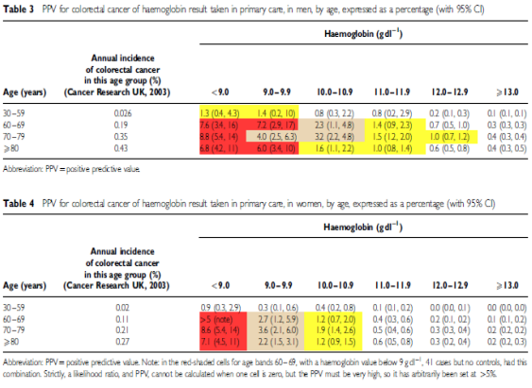
When the FIT is less than 10, think again (what was the pre-test probability)

Slide 25
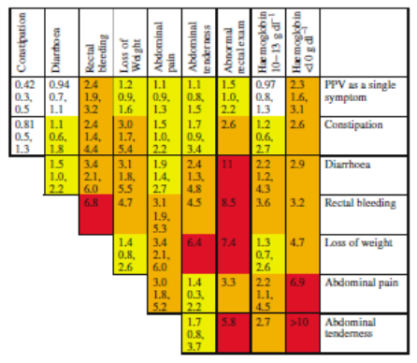
When the FIT is less than 10, think again (What was the pre-test probability)

Slide 26
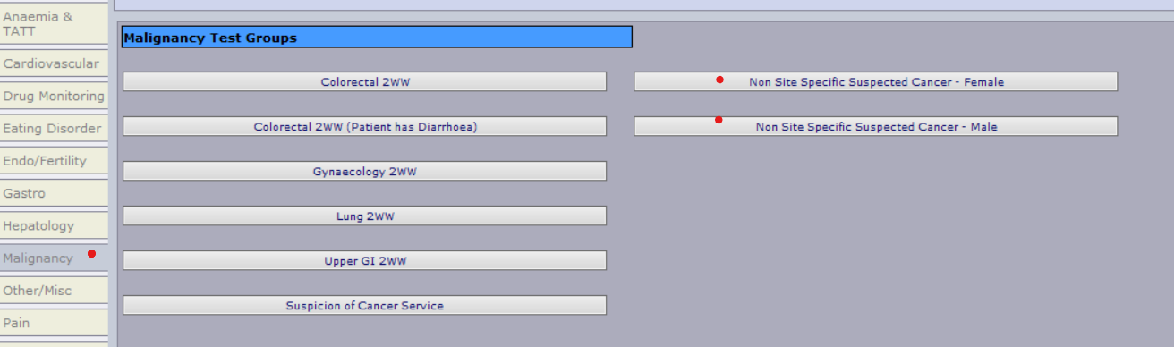
What to do with a negative FIT
Probably don’t refer people with a negative FIT test to colorectal…..
But if they have high risk symptoms or signs consider still referring, or another cancer pathway such as NSS, Upper GI, or direct access imaging.
Lots of crossover with ovarian – have you done a CA125?

Slide 27
Almost always look at a FIT result prior to considering lower GI USC referral.
Put a system in place to ensure that you have a result that you can act on.
Think about what to do with a negative test.

