Slide 1
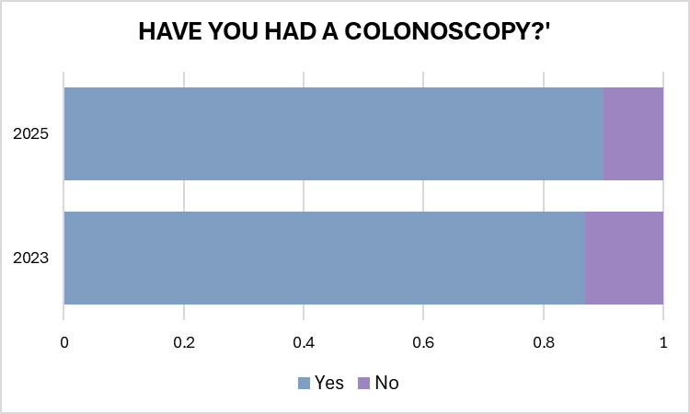
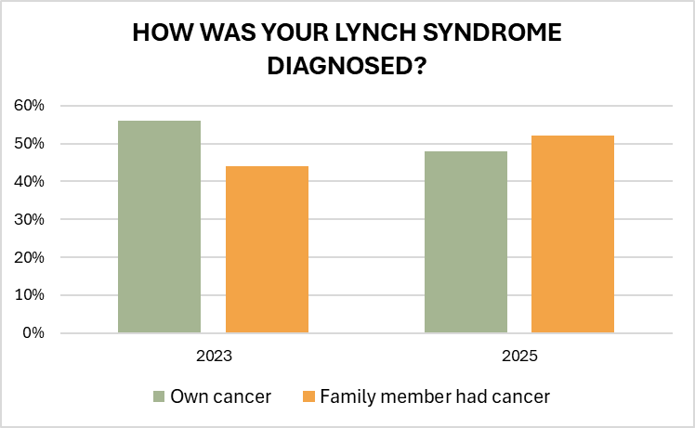
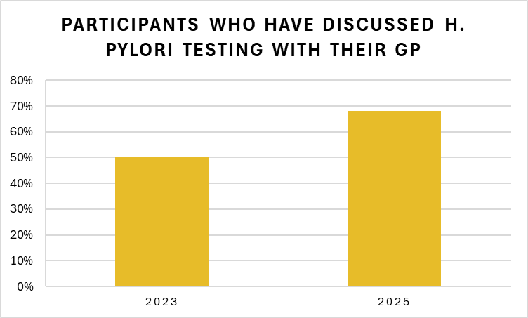



Introduction
Estimations suggest 1 in 350 people have Lynch syndrome (LS). The East Midlands Lynch Syndrome Expert Network (EMLSEN) was commissioned to improve LS testing and management. The EMLSEN MDT consists of healthcare professionals from oncology, colorectal surgery, gynaecology, clinical genetics, and GP; they seek to engage and support LS patients and family care in East Midlands (EM).
Purpose
Assess the EMLSEN impact in LS patients over 18 months.
Methods
Baseline data (BD) were collected August - October 2023, and follow-up data (FUD) were collected March – August 2025. BD established that 48 LS patients out of 214 participated (22.4% response rate), and FUD confirmed 143 participated out of 346 (41.3% response rate), representing a 19% increase in response rate.
Results
Comparisons of BD with FUD found an increase in patients diagnosed with LS through cascade testing (44% to 52%) versus their own cancer diagnosis. FUD found 18% more of participants discussed H pylori testing with their GP, and 13% more of LS patients reported currently taking chemoprevention compared to BD.
Conclusion
EMLSEN appears to be positively impacting LS care, however there is room for improvement. Next steps will include understanding the barriers for patients not having H pylori testing or taking chemoprevention.
Measuring the impact of the East Midlands Lynch Syndrome Expert Network (EMLSEN): 18-month follow-up
B. Stafford-Smith¹ MSc, V. Kiesel MS¹, P. Perry BSc¹ & J. Barwell MBBS, PhD^{1,2}
University Hospitals of Leicester, Infirmary Square, Leicester LE1 5WW, UK
University of Leicester, Department of Genetics and Genome Biology, University Road, Leicester, LE1 7RH, U
Family communication
There was little change in the percentage of participants who shared their LS results with relatives, with 77% (37/48) sharing this in 2023 and 78% (111/143) sharing this in 2025. The same number (n=2) of participants admitted to refusing to sharing their LS diagnosis with relatives in 2023 and 2025, however this represented a smaller percentage across the years as 4% in 2023 and 1.5% in 2025.
Utilisation of chemoprevention
Chemoprevention utility went from 14/47 (30%) in 2023 to 61/143 (43%) in 2025, representing a 13% increase among survey participants. In 2025, 17 participants (12%) shared that their GPs advised against aspirin in view of contraindications.
Colonoscopy screening
Most participants shared that they have had colonoscopy screening (41/47), 87%, in 2023, and reassuringly this number has increased slightly to 90% in 2025 (129/143). Notably, only 71% (34/48) of participants in 2023 and 73% of participants in 2025 were reportedly up to date with their colonoscopy screening.
Discussion
These survey results highlight improvements in LS patient care across EM. Since 2023, there is a higher proportion of people diagnosed with LS identified by cascade testing compared to diagnostic testing, an increased prevalence of LS patients discussing H pylori with their GPs, a higher percentage of participants taking chemoprevention and an increased percentage of respondents having colonoscopy screening.
Improvements have been made in LS care with advent of the EMLSEN, in view of their MDT meetings, clinics and events, GP education, screening support via the NDRS, the LS UK app and more. The LS UK app 270 patient users which is tracking bowel screening, gynaecological review, family cascading, aspirin use and helicobacter pylori testing in real time in over 270 users However, there is more to be done to ensure patients are up to date on colonoscopy screening, sharing genetic test results with relatives and more, to ensure that risk reduction is maximised for LS patients and their families.
Services offered across the UK vary and the use of aspirin as chemoprevention appears to be underutilised among LS patients (Ryan et al., 2020). Many healthcare providers view GPs as responsible for prescribing and overseeing the use of aspirin in those with LS, however GPs expressed being unfamiliar with using aspirin as a preventative therapy and were concerned about prescribing it in higher doses (Lloyd et al., 2022). The under-utilisation of chemoprevention in LS patients appears to be improving, but issues with uptake remain, and align with a wider issue.
Limitations
This data is affected by self-selection bias as information is only collected from engaged participants willing to share their experiences with LS. This means that this dataset is missing information from those less engaged with their LS diagnosis. Another limitation of this study is the median participant age of 59 years old; this highlights that insight gained from the EM LS population is skewed toward the experience of people from an older demographic, likely in part because older people may be more willing to engage in patient research.
Conclusion
There remains room for improvement in LS patient care in EM, which the EMLSEN seeks to continue to address with the support of monthly MDTs, multidisciplinary clinics, LS patient events and the LS UK app. Further investigations on this matter may be conducted in the future.
References
Lloyd, K.E., Foy, R., Hall, L.H., Ziegler, L., Green, S.M., Haider, Z.F., Taylor, D.G., MacKenzie, M. and Smith, S.G., 2022. Barriers and facilitators to using aspirin for preventive therapy: a qualitative study exploring the views and experiences of people with Lynch syndrome and healthcare providers. Hereditary Cancer in Clinical Practice, 20(1), p.30.
Ryan, N.A.J., Nobes, M., Sedgewick, D., Teoh, S.N., Evans, D.G. and Crosbie, E.J., 2021. A mismatch in care: results of a United Kingdom‐wide patient and clinician survey of gynaecological services for women with Lynch syndrome. BJOG: An International Journal of Obstetrics & Gynaecology, 128(4), pp.728-736.
Lynch syndrome diagnosis
The data show a slight shift from Lynch syndrome diagnoses being most often due to one’s own cancer diagnosis 56% (27/48) in 2023 compared to one’s Lynch syndrome diagnosis being due to a family member first being diagnosed with Lynch syndrome 52% (68/143) in 2025.
Lynch syndrome symptom awareness
When participants were asked if they knew what symptoms to look out in view of their LS diagnosis, BD from 2023 found 29% (14/48) of participants answered “no”, and FUD from 2025 found that 28% (38/142) of participants answered “no”, highlighting a slight decrease in those unaware of which symptoms to look out for.
Helicobacter pylori testing
Questionnaires from 2023 found that half (24/48) of participants discussed H. pylori testing with their GP, however, in 2025 there is an 18% increased with 97/143 participants claiming to have discussed H. pylori testing with their GPs.

